Slide 1


Filip

Slide 2

Outline
Executive Summary
Introduction
Methodology
Results
Conclusion
Appendix

Slide 3
Executive Summary
Summary of methodologies
Data collection through API
Data collection with Web Scraping
Data Wrangling
Exploratory Data Analysis with SQL
Exploratory Data Analysis with Data Visualization
Interactive Visual Analytics with Folium
Machine Learning Prediction
Summary of all results
Exploratory Data Analysis result
Predictive Analytics result

Slide 4
Introduction
Project background and context
Space X advertises Falcon 9 rocket launches on its website with a cost of 62 million dollars; other providers cost upward of 165 million dollars each, much of the savings is because Space X can reuse the first stage. Therefore, if we can determine if the first stage will land, we can determine the cost of a launch. This information can be used if an alternate company wants to bid against space X for a rocket launch. This goal of the project is to create a machine learning pipeline to predict if the first stage will land successfully.
Problems you want to find answers
What factors determine if the rocket will land successfully?
The interaction amongst various features that determine the success rate of a successful landing.
What operating conditions needs to be in place to ensure a successful landing program.

Slide 5

Section 1

Slide 6
Methodology
Executive Summary
Data collection methodology:
Data was collected from SpaceX API and webscraping
Perform data wrangling
The gathered data was enhanced by generating a landing result classification using outcome data, subsequent to summarizing and analyzing various features
Perform exploratory data analysis (EDA) using visualization and SQL
Perform interactive visual analytics using Folium and Plotly Dash
Perform predictive analysis using classification models
Data was standarized, divided into two groups: training data and test data. Then four different classification models were performed to find the best model.

Slide 7
Data Collection
Datasets were collected from SpaceX API (https://api.spacexdata.com/v4/rockets/)
from Wikipedia (https://en.wikipedia.org/wiki/List_of_Falcon/_9/_and_Falcon_Heavy_launches), using webscraping

Slide 8
Data Collection – SpaceX API
SpaceX provides a public API for accessing and utilizing data. The mentioned API was employed in accordance with the adjacent flowchart, followed by the persistence of data.
https://github.com/FilipK206/Applied-Data_Science_Capstone/blob/bca5f6143bb0ee7f38499e1aab8713a206e928b5/jupyter-labs-spacex-data-collection-api.ipynb
Retrieve data from the SpaceX launch API and parse it
Filter the dataframe to only include `Falcon 9` launches
Dealing with Missing Values

Slide 9
Data Collection - Scraping
Request the Falcon9 Launch Wiki page from its URL
Retrieve the names of all columns/variables from the HTML table header
Create a data frame by parsing the HTML tables containing launch information.
Present your web scraping process using key phrases and flowcharts
https://github.com/FilipK206/Applied-Data_Science_Capstone/blob/bca5f6143bb0ee7f38499e1aab8713a206e928b5/jupyter-labs-webscraping.ipynb

Slide 10
Data Wrangling
We conducted exploratory data analysis to establish the training labels. We computed the count of launches at each site, as well as the frequency of each orbit. Additionally, we generated a landing outcome label based on the outcome column and exported the results to a CSV file.
https://github.com/FilipK206/Applied-Data_Science_Capstone/blob/bca5f6143bb0ee7f38499e1aab8713a206e928b5/labs-jupyter-spacex-Data%20wrangling.ipynb

Slide 11
EDA with Data Visualization
We examined the data by visualizing the connections between flight number and launch site, payload and launch site, success rate for each orbit type, flight number and orbit type, and the yearly trend in launch success.
https://github.com/FilipK206/Applied-Data_Science_Capstone/blob/c753b01e2209e5ff56c56600780276f0fb41cecf/jupyter-labs-eda-dataviz.ipynb.jupyterlite.ipynb

Slide 12
EDA with SQL
We utilized exploratory data analysis (EDA) with SQL to extract insights from the data. We formulated queries to discover, for example:
The total payload mass carried by boosters launched by NASA (CRS).
The total number of successful and failed mission outcomes.
The names of unique launch sites in the space mission.
The average payload mass carried by booster version F9 V1.1.
The failed landing outcomes on the drone ship, along with their booster version and launch site names
https://github.com/FilipK206/Applied-Data_Science_Capstone/blob/bca5f6143bb0ee7f38499e1aab8713a206e928b5/jupyter-labs-eda-sql-coursera_sqllite.ipynb

Slide 13
Build an Interactive Map with Folium
We labeled all launch sites and incorporated map elements such as markers, circles, and lines to signify the success or failure of launches for each site on the Folium map. We assigned the launch outcomes to classes 0 and 1, where 0 represents failure and 1 represents success. Utilizing color-labeled marker clusters, we identified launch sites with relatively high success rates. cities.
https://github.com/FilipK206/Applied-Data_Science_Capstone/blob/c753b01e2209e5ff56c56600780276f0fb41cecf/lab_jupyter_launch_site_location.jupyterlite.ipynb

Slide 14
Build a Dashboard with Plotly Dash
We built an interactive dashboard with Plotly dash
We plotted pie charts showing the total launches by a certain sites
We plotted scatter graph showing the relationship with Outcome and Payload Mass (Kg) for the different booster version.
https://github.com/FilipK206/Applied-Data_Science_Capstone/blob/3af668170d0b95b057639f68862cfed75f1ddde5/spacex_dash_app.py

Slide 15
Predictive Analysis (Classification)
We loaded the data using NumPy and Pandas, performed data transformation, and divided it into training and testing sets. We constructed various machine learning models and fine-tuned different hyperparameters using GridSearchCV. Accuracy served as the metric for our model evaluation, and we enhanced the model through feature engineering and algorithm tuning. Ultimately, we identified the best-performing classification models.
https://github.com/FilipK206/Applied-Data_Science_Capstone/blob/c753b01e2209e5ff56c56600780276f0fb41cecf/SpaceX_Machine_Learning_Prediction_Part_5.jupyterlite.ipynb

Slide 16
Results
Exploratory data analysis results
There are four different launch sites: CCAFS LC-40, VAFB SLC-4E, KSC LC-39A, CCAFS SLC-40
Total payload mass carried by boosters launched by NASA (CRS): 45596 KG
Average payload mass carried by booster version F9 v1.1: 2535 KG
First succesful landing outcome in ground pad was achieved: 2015-12-22
total number of successful and failure mission outcomes: 101

Slide 17
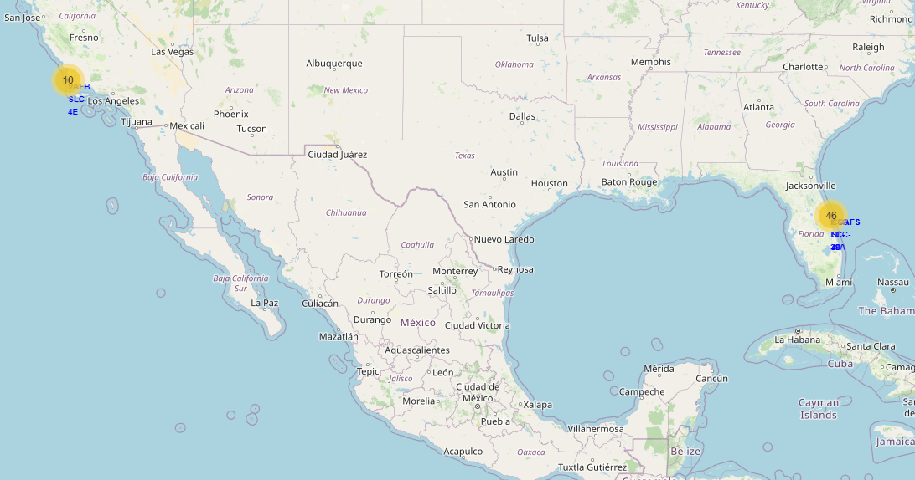
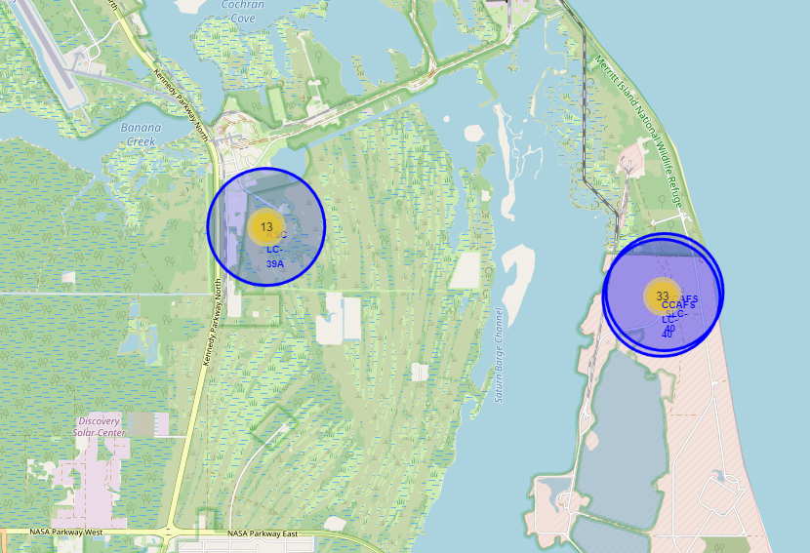
Results
Every launch site was located close to facilities like the coastline, highway and railway with a safe distance to the cities. Which increases the likelihood of a positive landing outcome.

Slide 18
Results
Predictive analysis results
Accuracy for Logistics Regression method: 0.834
Accuracy for Support Vector Machine method: 0.834
Accuracy for Decision tree method: 0.778
Accuracy for K nearest neighbours method: 0.834
The best models for this task are logistics regression, support vector machine method and K nearest neighbours.

Slide 19

Section 2

Slide 20
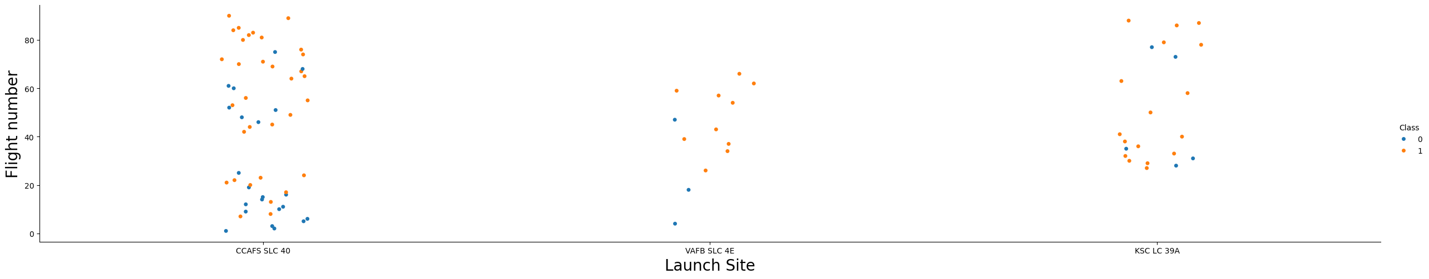
Flight Number vs. Launch Site
It appears that the greater the number of flights at a launch site the greater the succes rate at a launch site

Slide 21
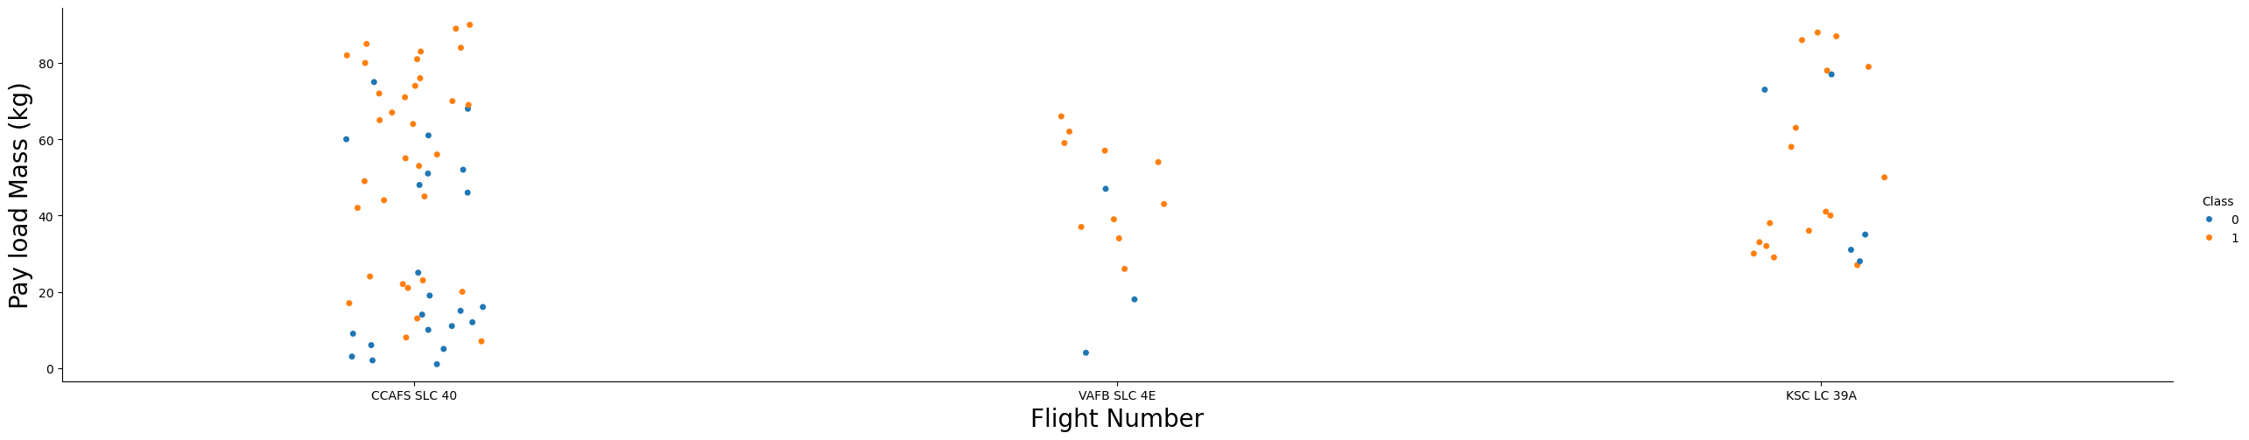
Payload vs. Launch Site
The most heavy payloads were conducted on a launch site CCAFS SLC 40.

Slide 22
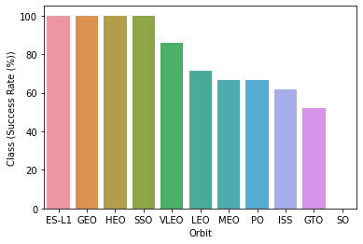
Success Rate vs. Orbit Type
The most success rate had ES-L1, GEO, HEO, SSO

Slide 23
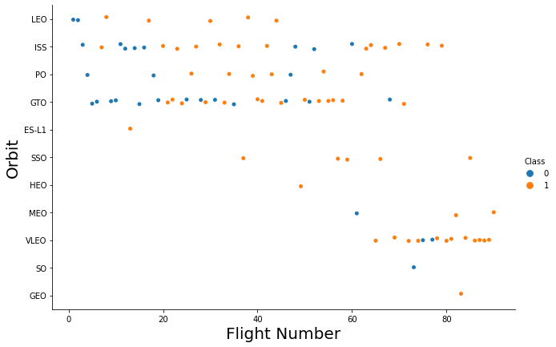
Flight Number vs. Orbit Type
The plot shows the Flight number vs Orbit type. We can see that the success is related to the number of flights for Orbit LEO and MEO.

Slide 24
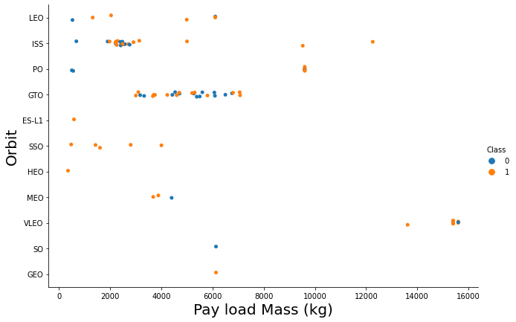
Payload vs. Orbit Type
The plot shows the Payload vs Orbit type. We can see that there is no relationship for the GTO orbit. There could be a correlation with heavy payload and success landing for PO, LEO and ISS orbits.

Slide 25
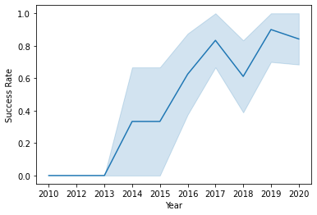
Launch Success Yearly Trend
The plot below shows that since 2013 success rate increased untill 2017

Slide 26
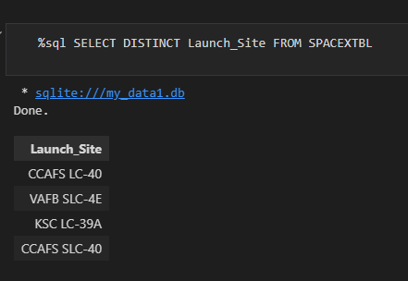
All Launch Site Names
We used the query with the key word DISTINCT to show only unique launch sites from the SpaceX data.

Slide 27
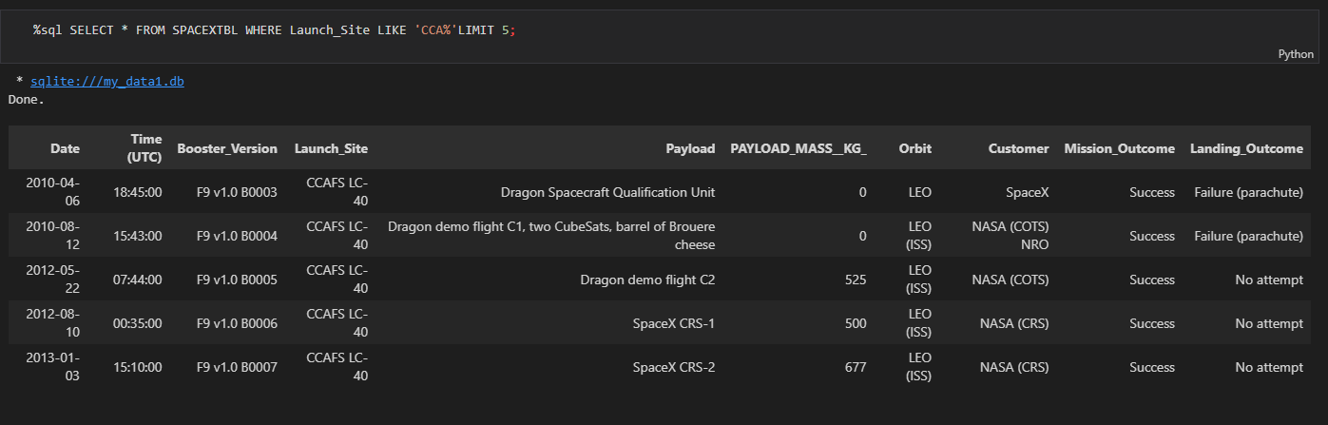
Launch Site Names Begin with 'CCA'
We used the query below to display 5 records where launch sites begin with „CCA”

Slide 28
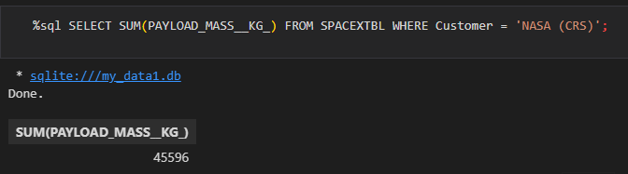
Total Payload Mass
We used the query below with a word SUM to calculate total payload carried by boosters from NASA.

Slide 29
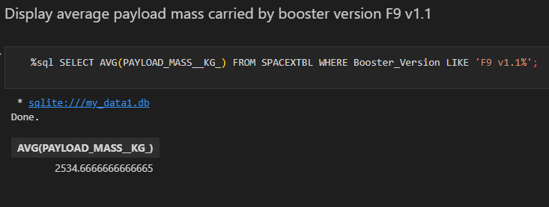
Average Payload Mass by F9 v1.1
We used the query below with a word AVG to get average payload carried by booster version F9 v1.1

Slide 30
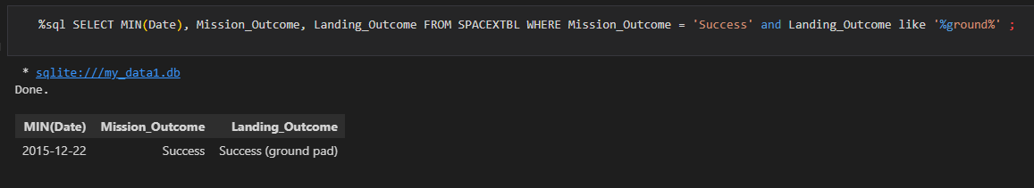
First Successful Ground Landing Date
We used the query below with word MIN to get first date for a succesful landing and word WHERE to filter the data.

Slide 31
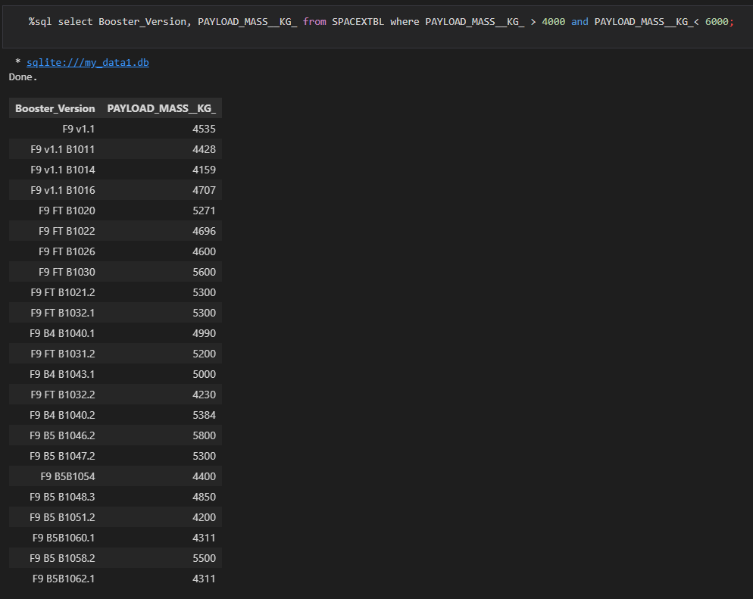
Successful Drone Ship Landing with Payload between 4000 and 6000
We used the query below with word WHERE to filter the data and obtain list of landings with Payload between 4000 and 6000

Slide 32
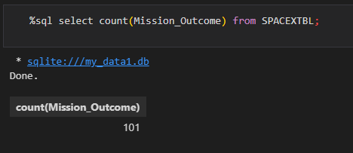
Total Number of Successful and Failure Mission Outcomes
We used the query with a word COUNT to obtain total number of succesful and failure mission outcomes.

Slide 33
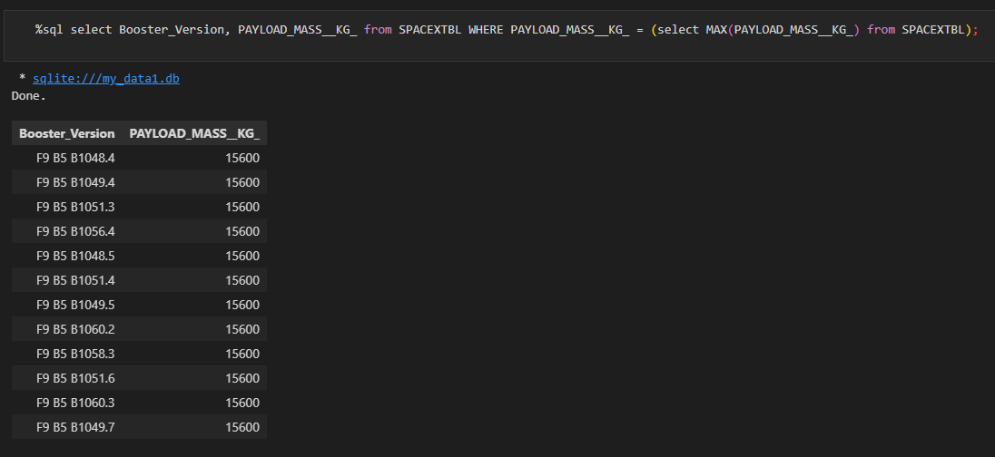
Boosters Carried Maximum Payload
We used the query with a word MAX to get maximum payload carried by boosters and word WHERE to filter the data.

Slide 34
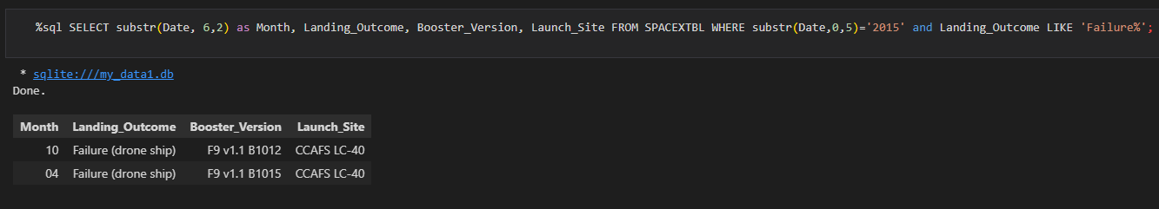
2015 Launch Records
We used the query with a phrase substr(Date, 6,2) to filter months and substr(Date, 0,5) to filter the year.

Slide 35
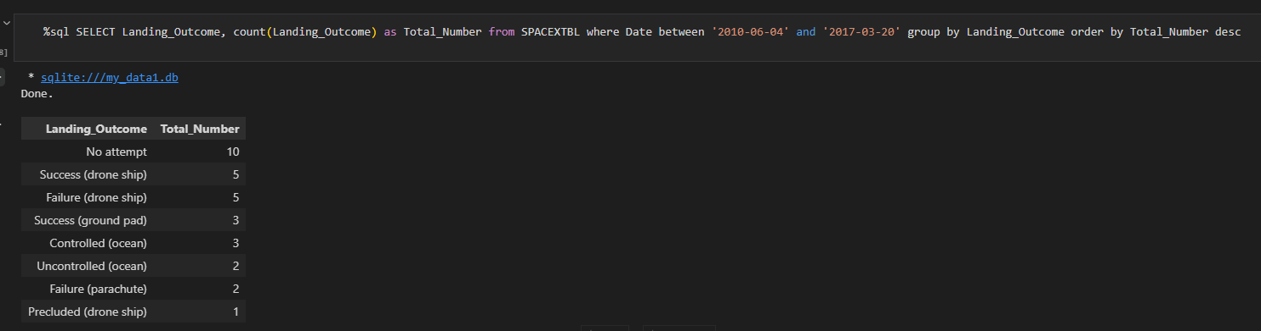
Rank Landing Outcomes Between 2010-06-04 and 2017-03-20
We used the query with a word WHERE to filter the data and GROUP BY to obtain grouped data

Slide 36

Section 3

Slide 37
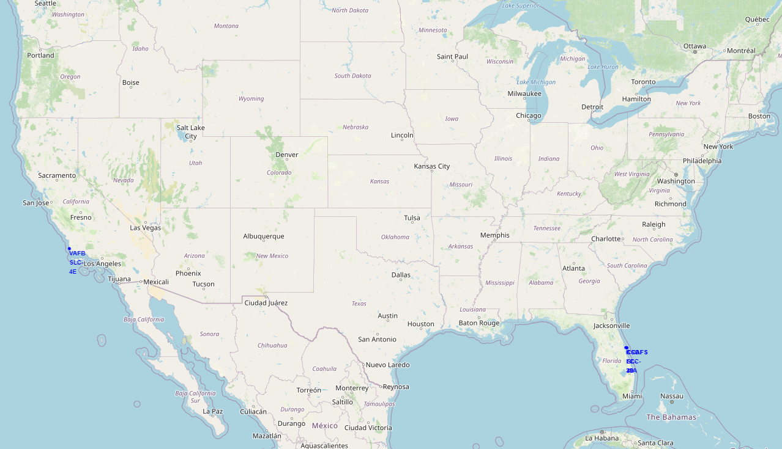
All launch sites global map markers
On the map below we can see that launch sites are located in United States of America in States California and Florida.

Slide 38
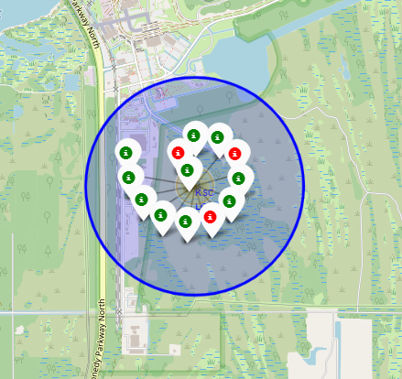
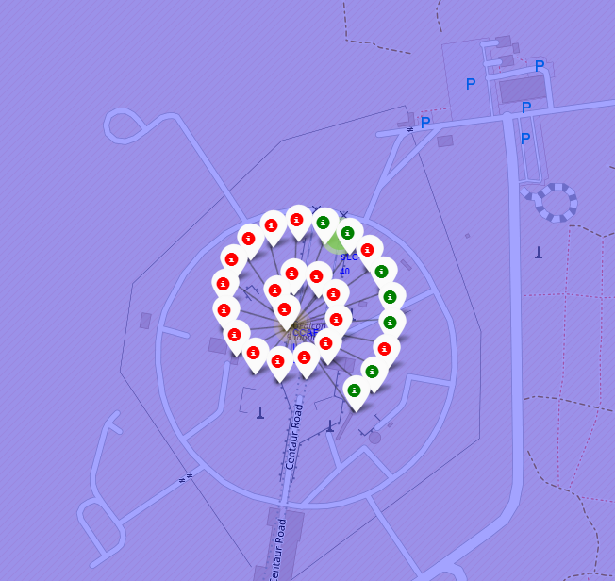
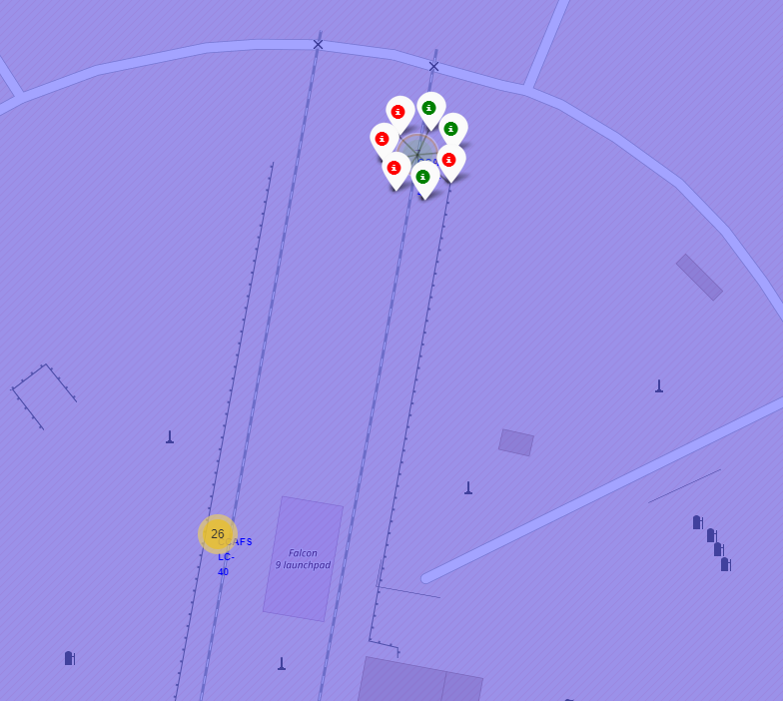
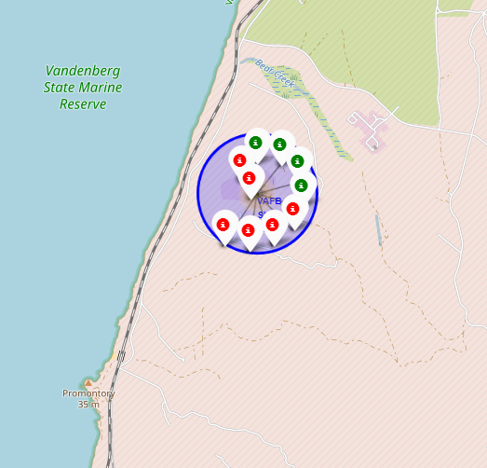
Markers showing launch sites
Green markers shows successful launches and Red markers shows failures.

Slide 39
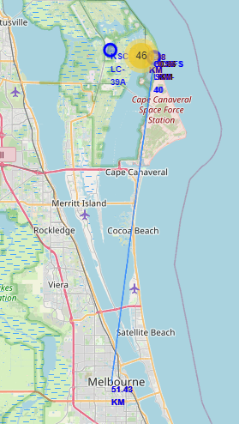
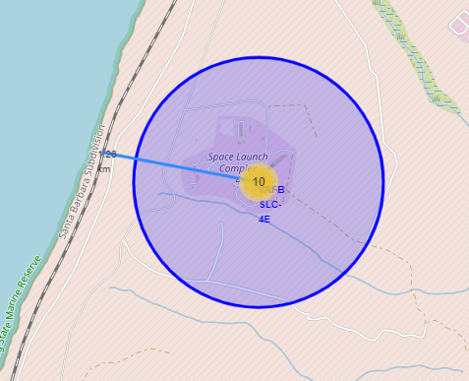
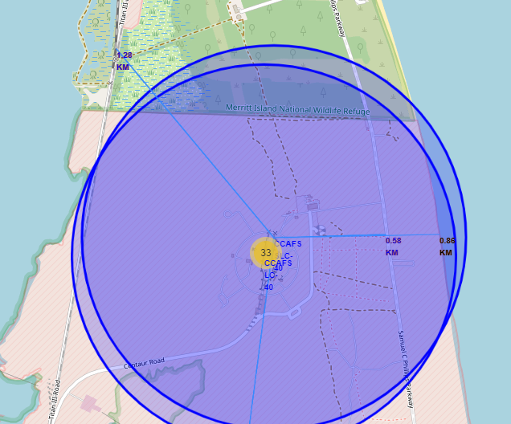
Launch Site distance to landmarks
On the maps shown above we can see the distance between the launch sites and the railway, coastline, highway and the city.

Slide 40

Section 4

Slide 41
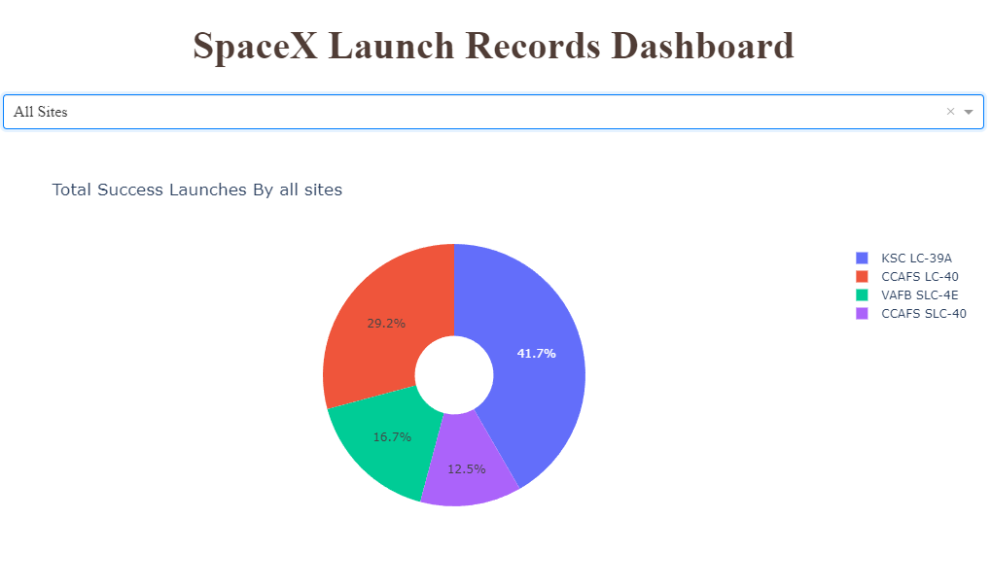
SpaceX Launch Records Dashboard
We can see below the pie chart with a total success launches by all sites.
KSC LC-39A had the best performance from all launch sites.

Slide 42
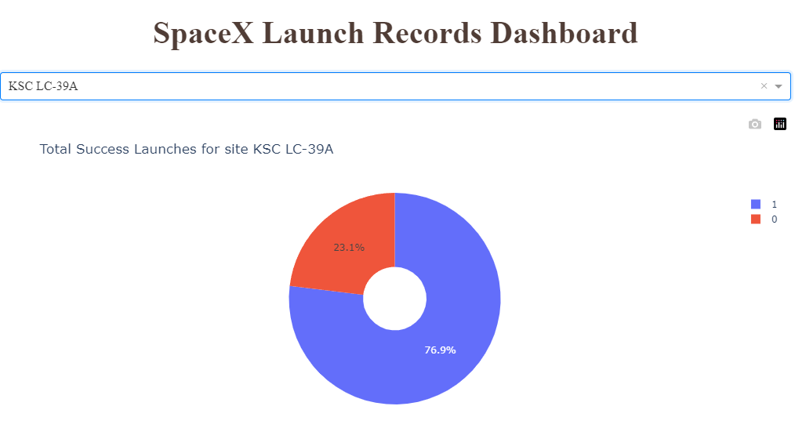
Total success launches for site KSC LC-39A
On the pie chart below we can see that a success rate for this launch sites was 76.9% and failure rate was 23.1%

Slide 43
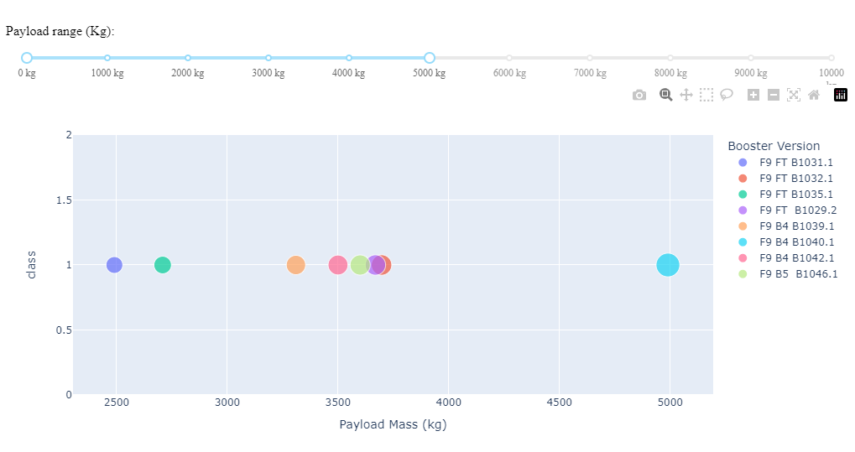
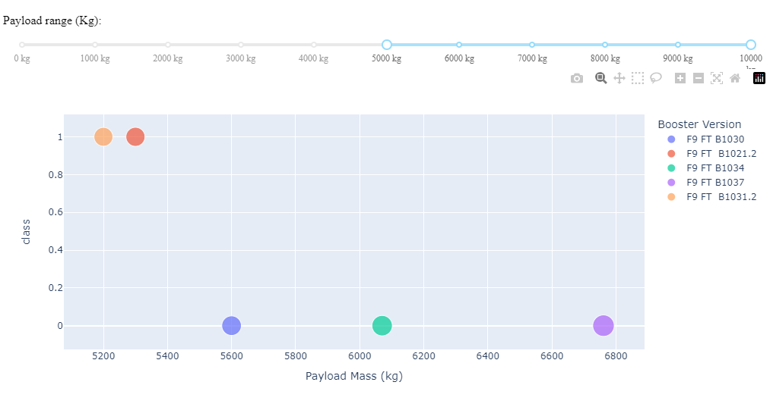
Payload vs Launch Outcome
We can see below performance of all launch sites divided into groups, low weighted payloads (0kg – 5 000kg). and heavy weighted payloads (5 000kg – 10 000kg).

Slide 44

Section 5

Slide 45
Classification Accuracy
Predictive analysis results
Accuracy for Logistics Regression method: 0.834
Accuracy for Support Vector Machine method: 0.834
Accuracy for Decision tree method: 0.778
Accuracy for K nearest neighbours method: 0.834
The best models for this task are logistics regression, support vector machine method and K nearest neighbours.

Slide 46
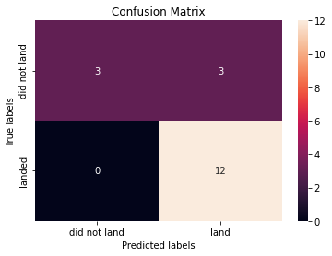
Confusion Matrix
We can see below confusion matrix. All three best-performing models got equally the same scores, therefore there is only one confusion matrix.

Slide 47
Conclusions
We can conclude that:
The larger the flight amount at a launch site, the greater the success rate at a launch site.
Launch success rate started to increase in 2013 untill 2017.
Orbits ES-L1, GEO, HEO, SSO had the most success rate.
KSC LC-39A had the most successful launches of any sites.
The best models for this task are logistics regression, support vector machine method and K nearest neighbours.

Slide 48
Appendix
None

Slide 49


